Slide 1

A Web Platform for Public Involvement: Reviewing Patient Information Leaflets for UK Clinical Trials
Fernando Santos
Supervisors:
Prof Thanassis Tiropanis
Prof Jeremy Wyatt

Slide 2
The Problem
Current Patient Information Leaflets (PILs) are hard for patients and public audiences to understand
PILs are to support patient decisions about entering a trial, so must be understandable by all patients
Employing a Patient and Public Involvement group to review PIL can be too expensive (c. £20 per person-hour) & time consuming for pragmatic, low-risk trials
Quantitative text metrics and analytics can identify difficult sentences for patients, but give no advice on how to correct them.

Slide 3
Our proposal
Assess the effect of different content analysis and crowd sourcing techniques for revising PILs
Use different quantitative metrics to assess difficulty of understanding sample PILs.
Collect public feedback on sample PILs online:
Record user comments
Link comments to specific sections of text
Quantitatively assess sentence issues
Employ Amazon crowd sourcing to revise wording of sentences identified as too hard to understand.

Slide 4
Methods
Invited PIL authors from UK clinical trials to collaborate in the study, authors from FLUPOC, HORIZON and TrueNTH studies responded
Four PILs currently in use selected to test our platform.
Several indexes used to quantify readability of current PIL text.
Sentences in each PIL requiring above 10th grade schooling were identified using XXX
Public comments and reviews (EQIP scale) on PIL text gathered online.
In progress: studying how different techniques (Cloze procedure, sentiment analysis, crowdsourcing) affect the revision quality of difficult sentences.

Slide 5
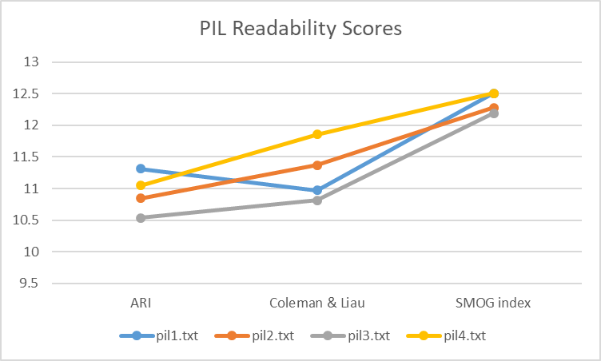
Initial Results
We have obtained some initial results for this study
No meaningful difference in readability was observed for the 4 PILs using 3 different scores: ARI, Coleman and SMOG.

Slide 6
Initial Results
The text of all PILs contained a similar number of hard sentences and similar score distributions.
In all cases more than 1/3 of the sentences were deem to be too hard to understand. 1/4 of the sentences would require a professor level reading skill to be easily understood.
Professor Level
PIL | Sentences | Sentences Above 10 | Percentage
1 | 78 | 29 | 37%
2 | 133 | 46 | 35%
3 | 60 | 19 | 32%
4 | 136 | 47 | 35%
PIL | Upper | Lower | Q1 | Q2 | Q3
1 | 37.67 | 10.28 | 12.92 | 15.25 | 20.36
2 | 40.93 | 11.27 | 13.83 | 15.95 | 19.19
3 | 25.32 | 11.04 | 14.31 | 16.02 | 20.35
4 | 43.25 | 11.41 | 13.53 | 16.21 | 18.72
College Student

Slide 7
Initial Results
Pilot run to assess the viability of employing Amazon crowdsourcing to revise the sentences
2 Groups, each of 9 revisers, revised 4 sentences from PIL 1. One sentence from each score quartile taken at random.
Revisers asked to fill-in missing words for each sentence (Cloze procedure) before making the revisions to validate quality.
Acceptable level of quality for the revisions:
Revisers | Approved Revisions | Avg Revisions per Reviser | Std Dev
9 | 23 (66%) | 3.8 | 0.4
9 | 22 (62%) | 4 | 0

Slide 8
Initial Results
Sentence | Original Sentence Score | Group | Revisions Avg Score | Percentage of Improvement
If you are in Group A your samples will be analysed for many different viruses using the rapid test which takes about 1 hour. | 10.5 | Unaided | 6.7 | 37%
 |  | Tip List | 8.0 | 25%
The clinical team looking after you may wish to test you for respiratory viruses and if they do this will be using standard laboratory testing | 13.3 | Unaided | 10.9 | 18%
 |  | Tip List | 9.4 | 30%
For both Groups A and B you have the right to decline all or any of these further research samples, should you wish, and this will not affect you being part of this study or the care you receive. | 16.7 | Unaided | 9.3 | 44%
 |  | Tip List | 9.5 | 43%
The samples collected during the study are stored without any of personal details on them and are only used in further ethically approved research under the direction of the chief investigator of this study. | 19.5 | Unaided | 13.2 | 32%
 |  | Tip List | 14.4 | 26%

Slide 9
Initial Results – sample sentence revisions
Sentence | G1 | G2
if you are in Group A your samples will be Analysed for many different viruses using the rapid test which takes about 1 hour. | If you are in Group A your test will be conducted within an hour. | If you are in Group A, a 1 hour test will check for viruses in your samples.
The clinical team looking after you may wish to test you for respiratory viruses and if they do this will be using standard laboratory testing | The staff taking care of you may want to examine you for and breathing problems. If they do they will use standard testing. | The team looking after you may want to test you for respiratory viruses. If so, this will use standard laboratory testing.
For both Groups A and B you have the right to decline all or any of these further research samples, should you wish, and this will not affect you being part of this study or the care you receive. | For both groups A and B you can opt out at any time. This will not affect your participation in the study or further care. | If you are in Group A or B, you may choose not to provide further research samples. This will not affect the care you receive now or remove you from this study.
The samples collected during the study are stored without any of personal details on them and are only used in further ethically approved research under the direction of the chief investigator of this study. | The samples will that are taken will only be used for respectful research and they will not contain any information that points to yourself. | Samples are stored confidentially and no personal data will be listed on them. They will only be used in further ethically approved studies as directed by the chief investigator of this trial.

Slide 10


THANK YOU
Fernando Santos
fss1g15@soton.ac.uk
https://www.wppi.soton.ac.uk/authors.html

